Slide 1
RStudio, Git, & GitHub

Slide 2
R & RStudio
What is R?
  R is a language and environment for statistical computing and graphics.
What is RStudio?
  It is a free and open-source integrated development environment (IDE) for R.

Slide 3
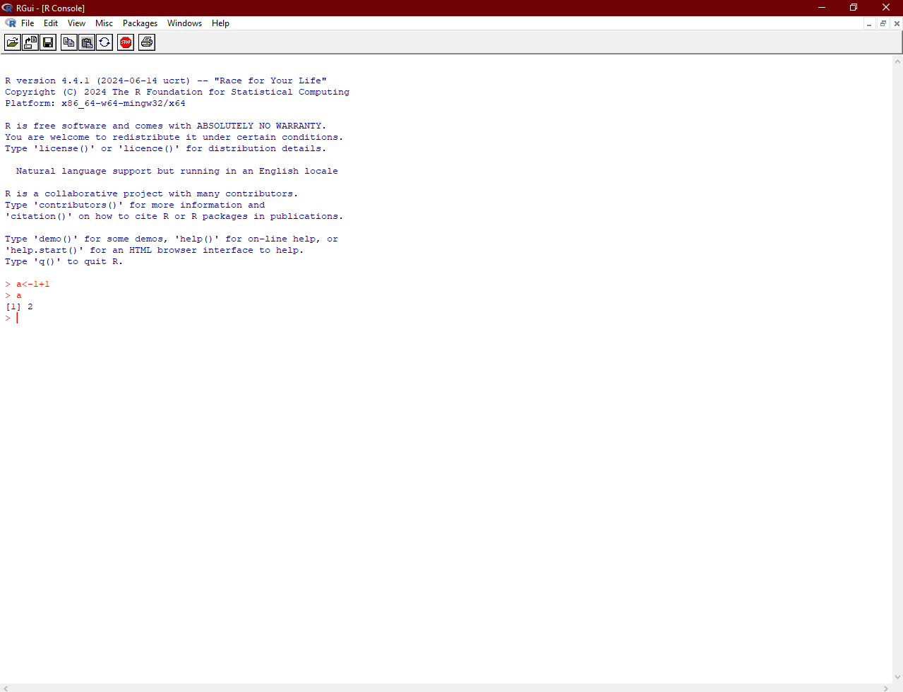

Slide 4
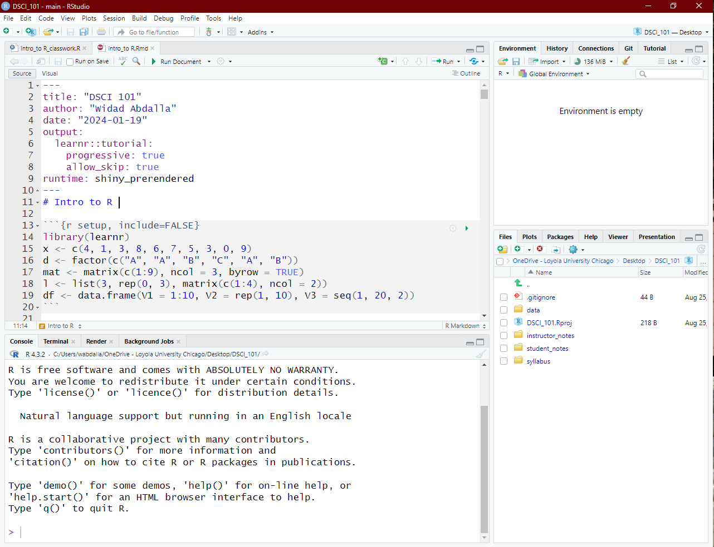

Slide 5
Installing R & RStudio

Slide 6
Git
Git is a version control system that helps you keep track of changes in your code or any other files. It’s like a time machine for your work. Git allows you to:
Track Changes
Collaborate with Others
Create Backups
Work Offline

Slide 7
GitHub
GitHub is a web-based platform that uses Git for version control. It’s like a social network for programmers and a hosting platform for Git repositories. Here’s what you can do with GitHub:
  Store Code in the Cloud
  Collaborate with Others
  Share Your Work
  Issue Tracking

Slide 8
Installing Git

Slide 9
RStudio and GitHub

Slide 10
Things for you to do before next class:
  Read the RStudio, Git, & GitHub document.
  Install R & RStudio
  Install Git
  Clone the class repository (under RStudio and GitHub section)
  Take the class survey

